Slide 1

Research Paper Recommendation System
Discover your next breakthrough automatically with our intelligent research paper recommendation system. It's designed to streamline your academic journey.

Slide 2

The Research Problem
Researchers often face significant challenges in finding relevant papers. Our system addresses these pain points directly.
Wasted Time
Forgotten Reads
Spend less time searching, more time researching. Hours are lost weekly on inefficient discovery.
Never forget a paper you've already read. Our system keeps track of your progress.
Missed Insights
Stay current with important new research. Avoid missing crucial developments in your field.

Slide 3




How It Works
Our system simplifies the discovery process. It's an intuitive three-step method for tailored recommendations.
Search
Start with a specific keyword or topic.
Rate
Provide feedback on papers you like.
Recommendations
Receive personalized suggestions immediately.
For example, "Like 2 AI papers → Get 10+ similar suggestions!"

Slide 4




Key Features
Explore the powerful features designed to enhance your research workflow. Each feature helps you stay organized and informed.
Reading History
Trending Alerts
One-Click rate
Learns Your Taste
Keep a comprehensive log of all your viewed papers. Revisit them anytime.
Get notified about the hottest new research. Stay ahead of the curve.
The system adapts to your preferences over time. Recommendations become more precise.
Easily save important papers for later reference. Organize your library effortlessly.

Slide 5
Technology Simplified
Our advanced technology makes finding relevant papers effortless. We leverage sophisticated algorithms for accuracy.
Intuitive Design
AI-Powered Matching
User-friendly interface for seamless navigation. Easy to learn and operate for all users.
Works like TikTok's algorithm—but for papers! Our AI understands your preferences.

Slide 6
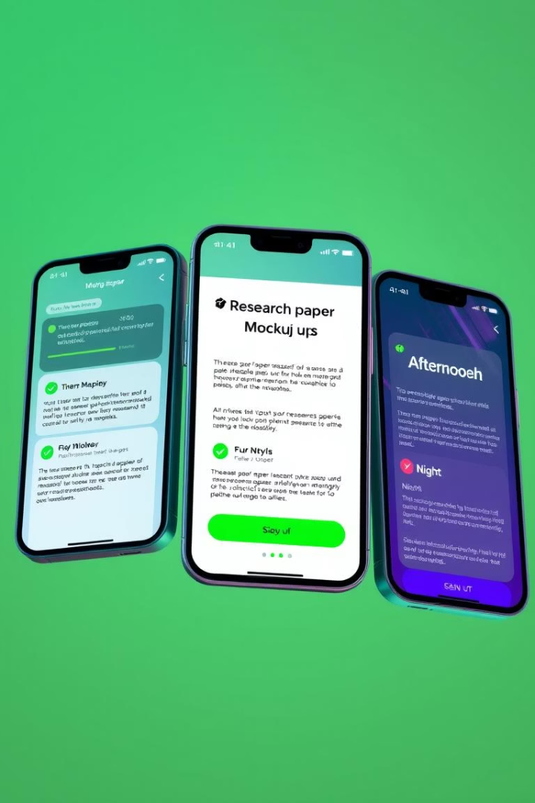
Daily Usage
Integrate the recommendation system seamlessly into your daily routine. Optimize your research time every day.
1
recommendations
Check daily recommendations. Start your day with new insights.
2
specific topic
Search for a specific topic. Dive deep into particular areas.

Slide 7

Future Upgrades
We are continuously developing new features to enhance your experience. Look forward to these exciting additions.
Voice Search
Search for papers using natural voice commands. Hands-free research is coming soon.
Team Sharing
Collaborate effortlessly with your colleagues. Share papers and insights within your team.
Weekly Digest
Receive a curated summary of new papers. Stay informed with minimal effort.

Slide 8

Thanks.

